Slide 1
ECE 2015
Image Processing
Final Project
---------Jianyu Shen
(JIS77@pitt.edu)

Slide 2
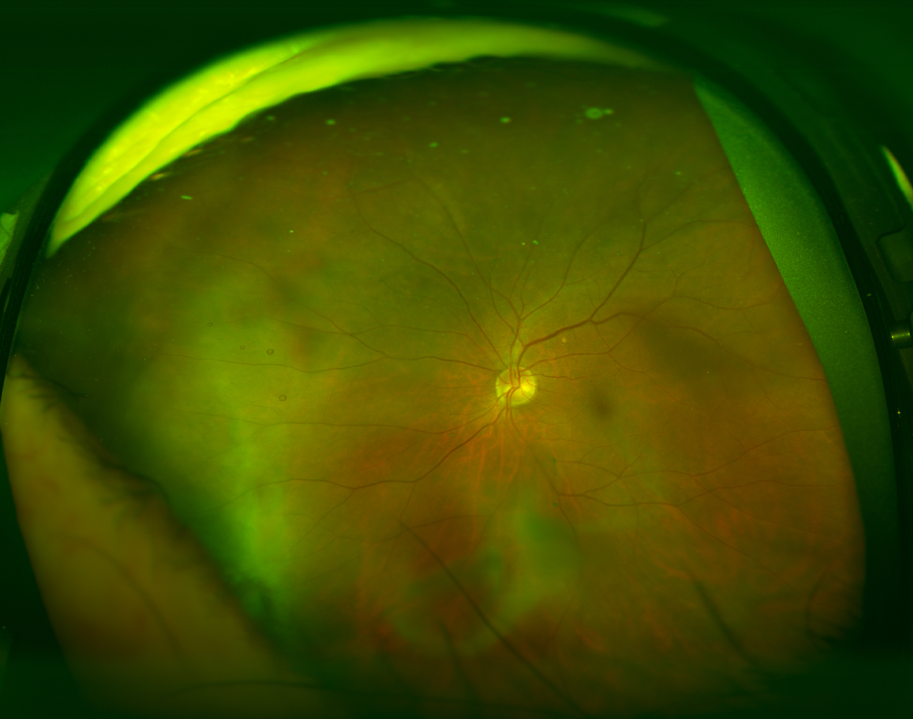
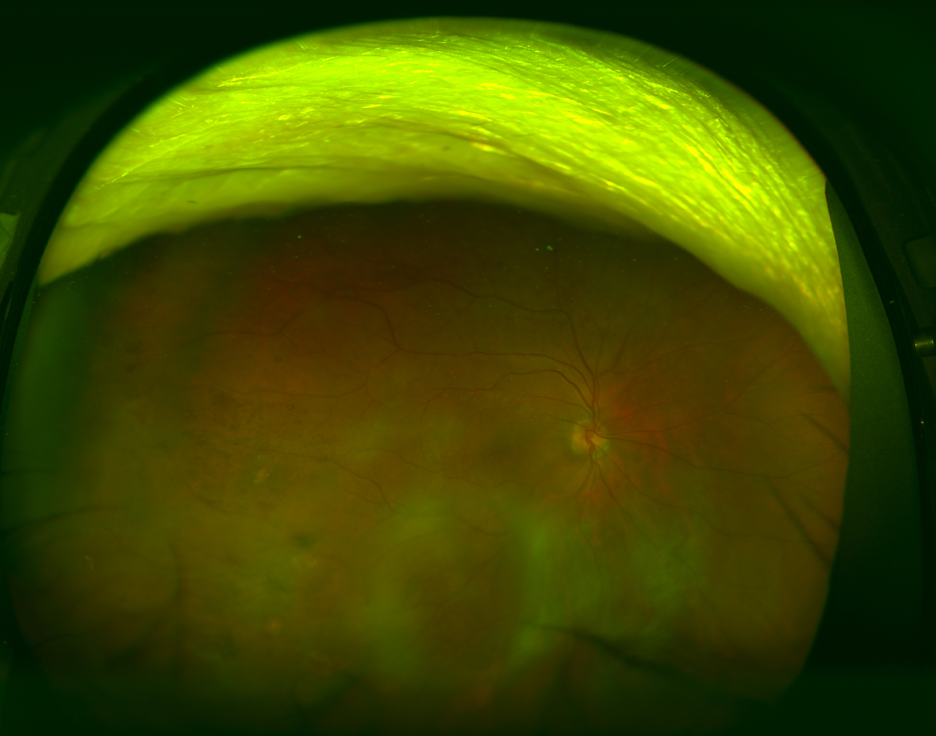
Original Image
Two retina images

Slide 3
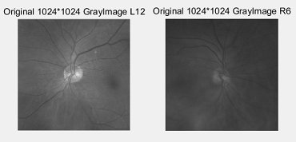
Prerequisite
Crop out 1024 x 1024 pixels from 3900 x3072 pixels image.

Slide 4
Aim
1.Segmentation out the optical disk and main vessels
2.Evaluate statistical texture in each image by Gabor method

Slide 5
Achieve prerequisite
Imcrop() ------- clipping figure
rgb2gray() ------- gray level image

Slide 6
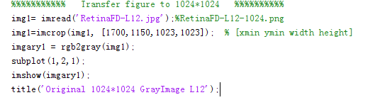
Outcome & Code

Slide 7
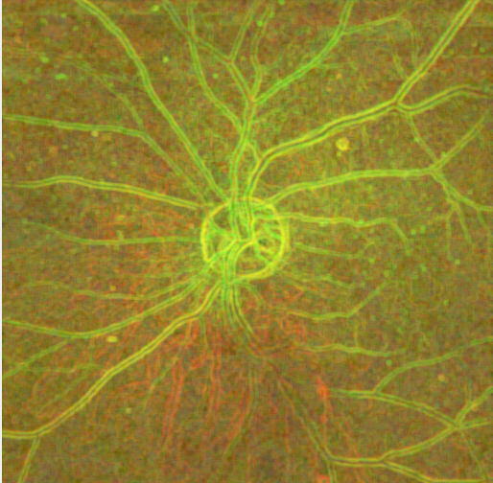
Texture Segmentation
Step 1: Use entropyfilt to create a texture image.
Entropy is a statistical measure of randomness,it returns an array where each output pixel contains the entropy value of the 9-by-9 neighborhood around the corresponding pixel in the input image I.
E = entropyfilt(img1);
Eim = mat2gray(E); %rescale the texture image E so that its
values are in the default range for a
double image.

Slide 8
Step 2
Step 2: Create Rough Mask for the Bottom Texture
Threshold the rescaled image Eim to segment the textures.
BW1 = im2bw(Eim, .8);%intensity value of pixels along the
boundary between the textures.
closeBWao = imclose(bwareopen(BW1,2000),true(9));
roughMask = imfill(closeBWao,'holes');%Use imfill to fill holes
in the object in
CloseBWao.
Not Very Well used in bottom texture:bottom texture is segmented
almost in its entirety.

Slide 9

Step 3:Use Rough Mask to Segment the Top Texture
BW2 = im2bw(mat2gray(E2),graythresh(E2im));
%Use entropyfilt to calculate the texture
image.
mask2 = bwareaopen(BW2,1000);
%Threshold E2im using graythresh.segmented in
BW2.
%Use bwareaopen to get a mask for the top
Texture.
Good use in top texture!

Slide 10
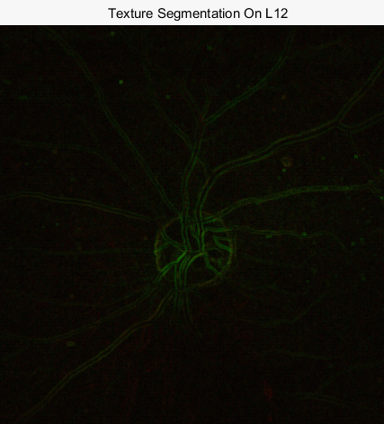
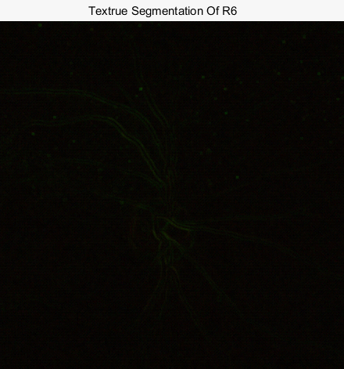
Step 4
Display Segmentation Results.Use mask2 to extract the top and bottom texture from I.

Slide 11
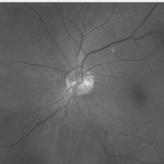
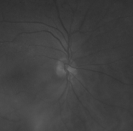
Outcome

Slide 12
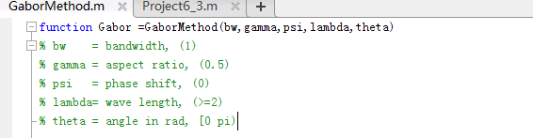
Gabor Method

Slide 13
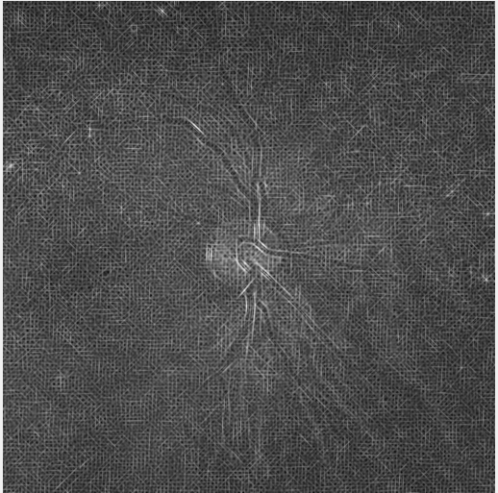
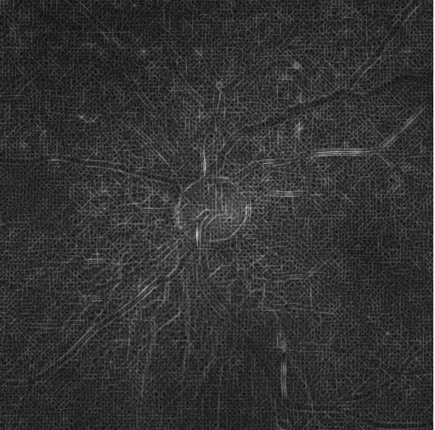
Outcome of two figure
The features are almost the same.
The right figure seems have more energy than the left one.

